Slide 1
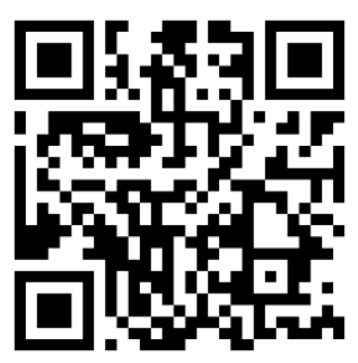
QR CODE GENERATOR APP
BY
ATMARAM KISHOR PAWAR
ROLL NO : 55
UNDER GUIDANCE OF
MRS. CALVINA MAHARAO
DEPARTMENT OF INFORMATION TECHNOLOGY

Slide 2
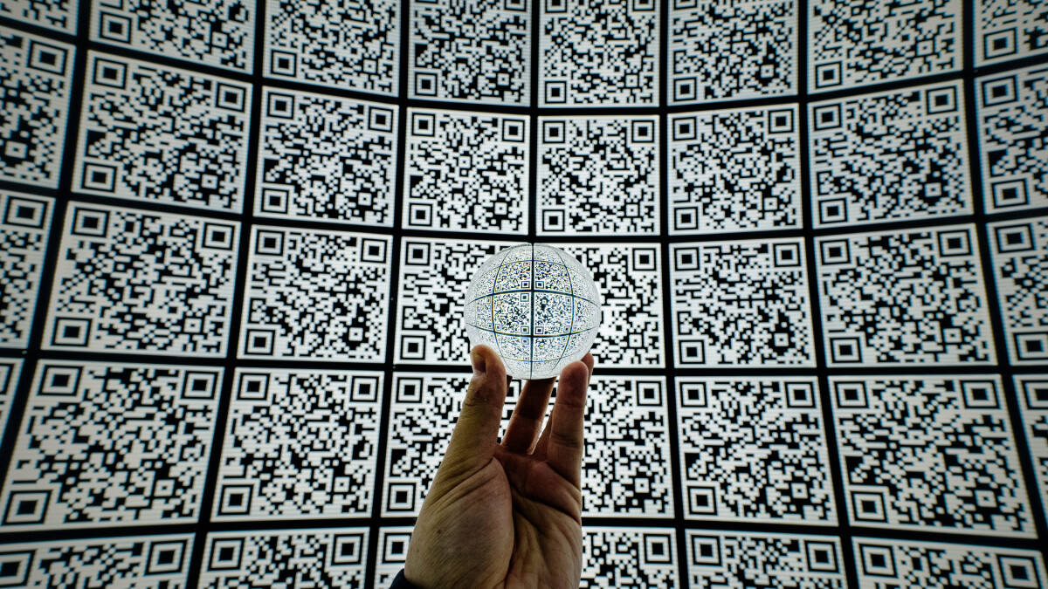
QR CODE
Quick Response Code
Invented by Masahiro Mara from the Japanese company Denso wave
2 D barcode
Easily scan
Store more data

Slide 3
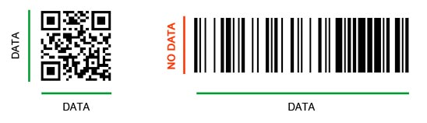
QR CODE VS BARCODE
QR (2D)
QR contain data in horizontal & vertical directions
Large storage capacity (7089 numeric char,4296 alphanumeric char,,2953 bytes,1817 kanji char)
Barcode (1D)
Barcode contain data in horizontal direction
small storage capacity (Only store around 20-25 characters)

Slide 4
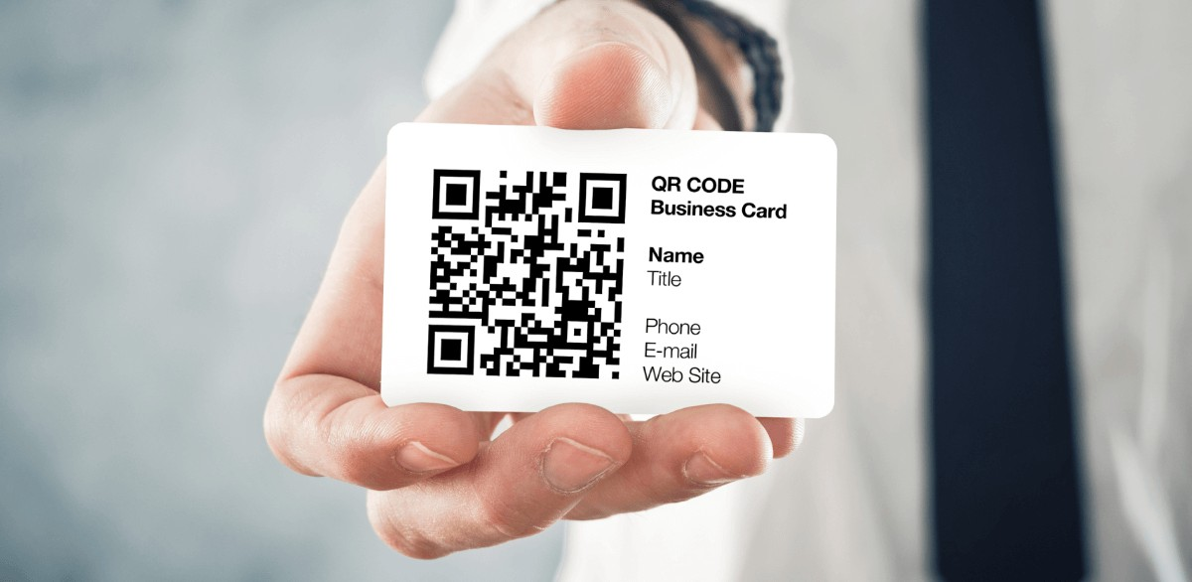
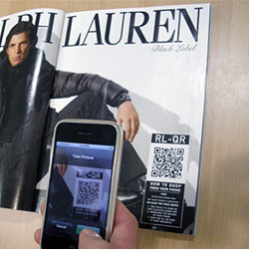
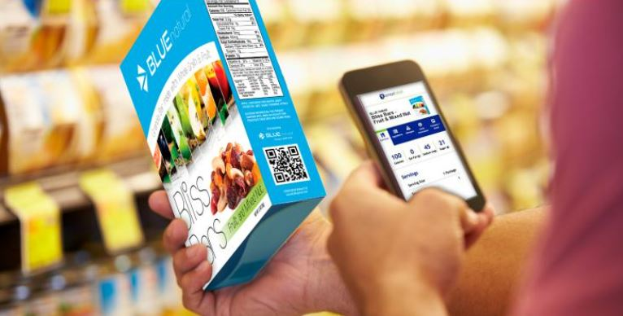

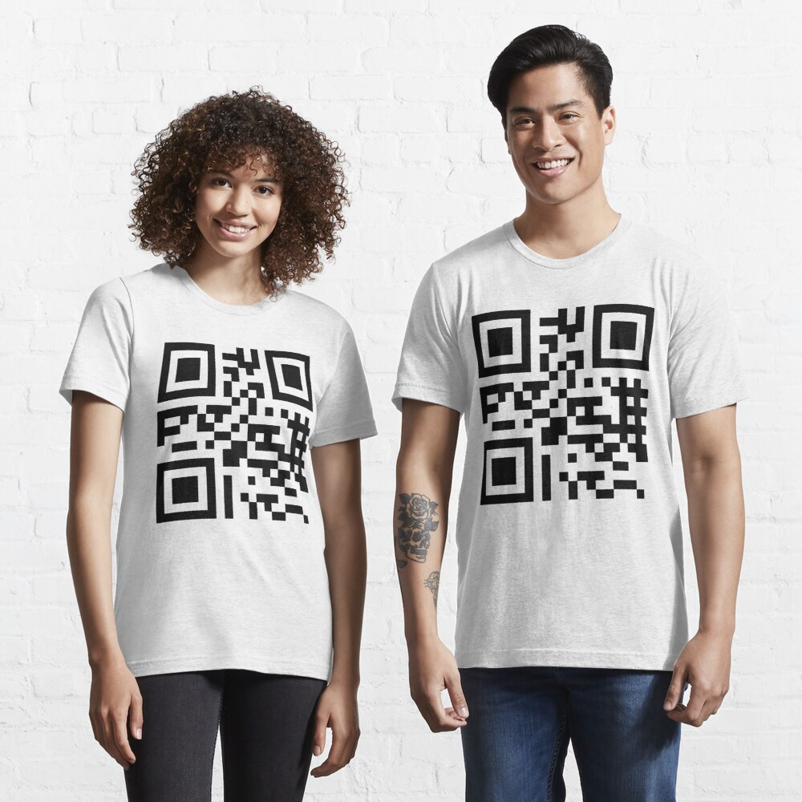
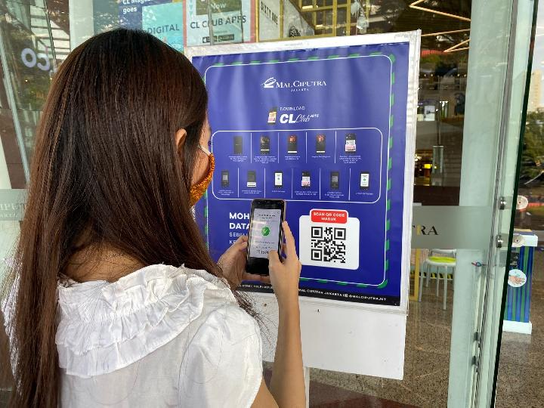
USE OF QR CODES
Visiting Card Magazine & Newspapers Packaging Products
ID Card Clothes & Wearables Shopping mall

Slide 5
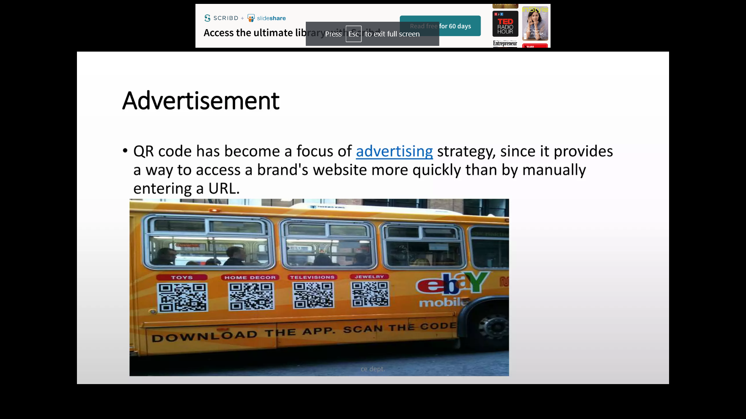
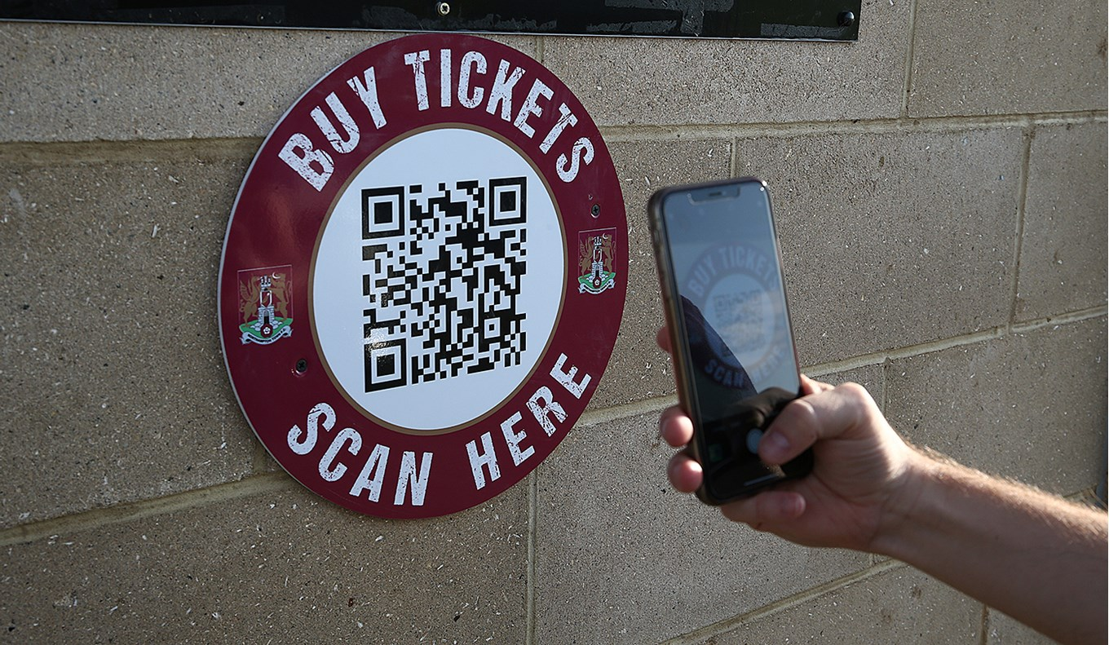
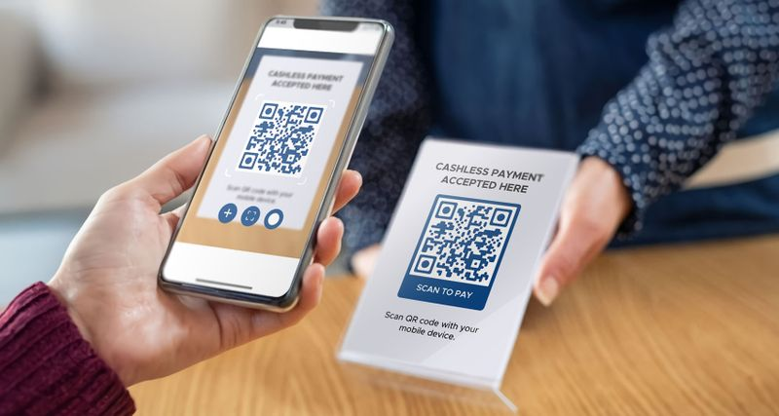
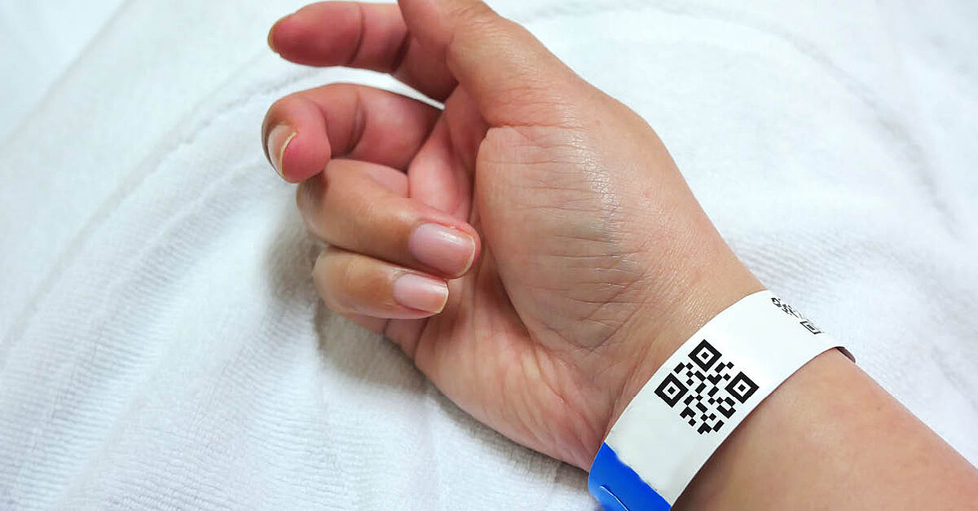
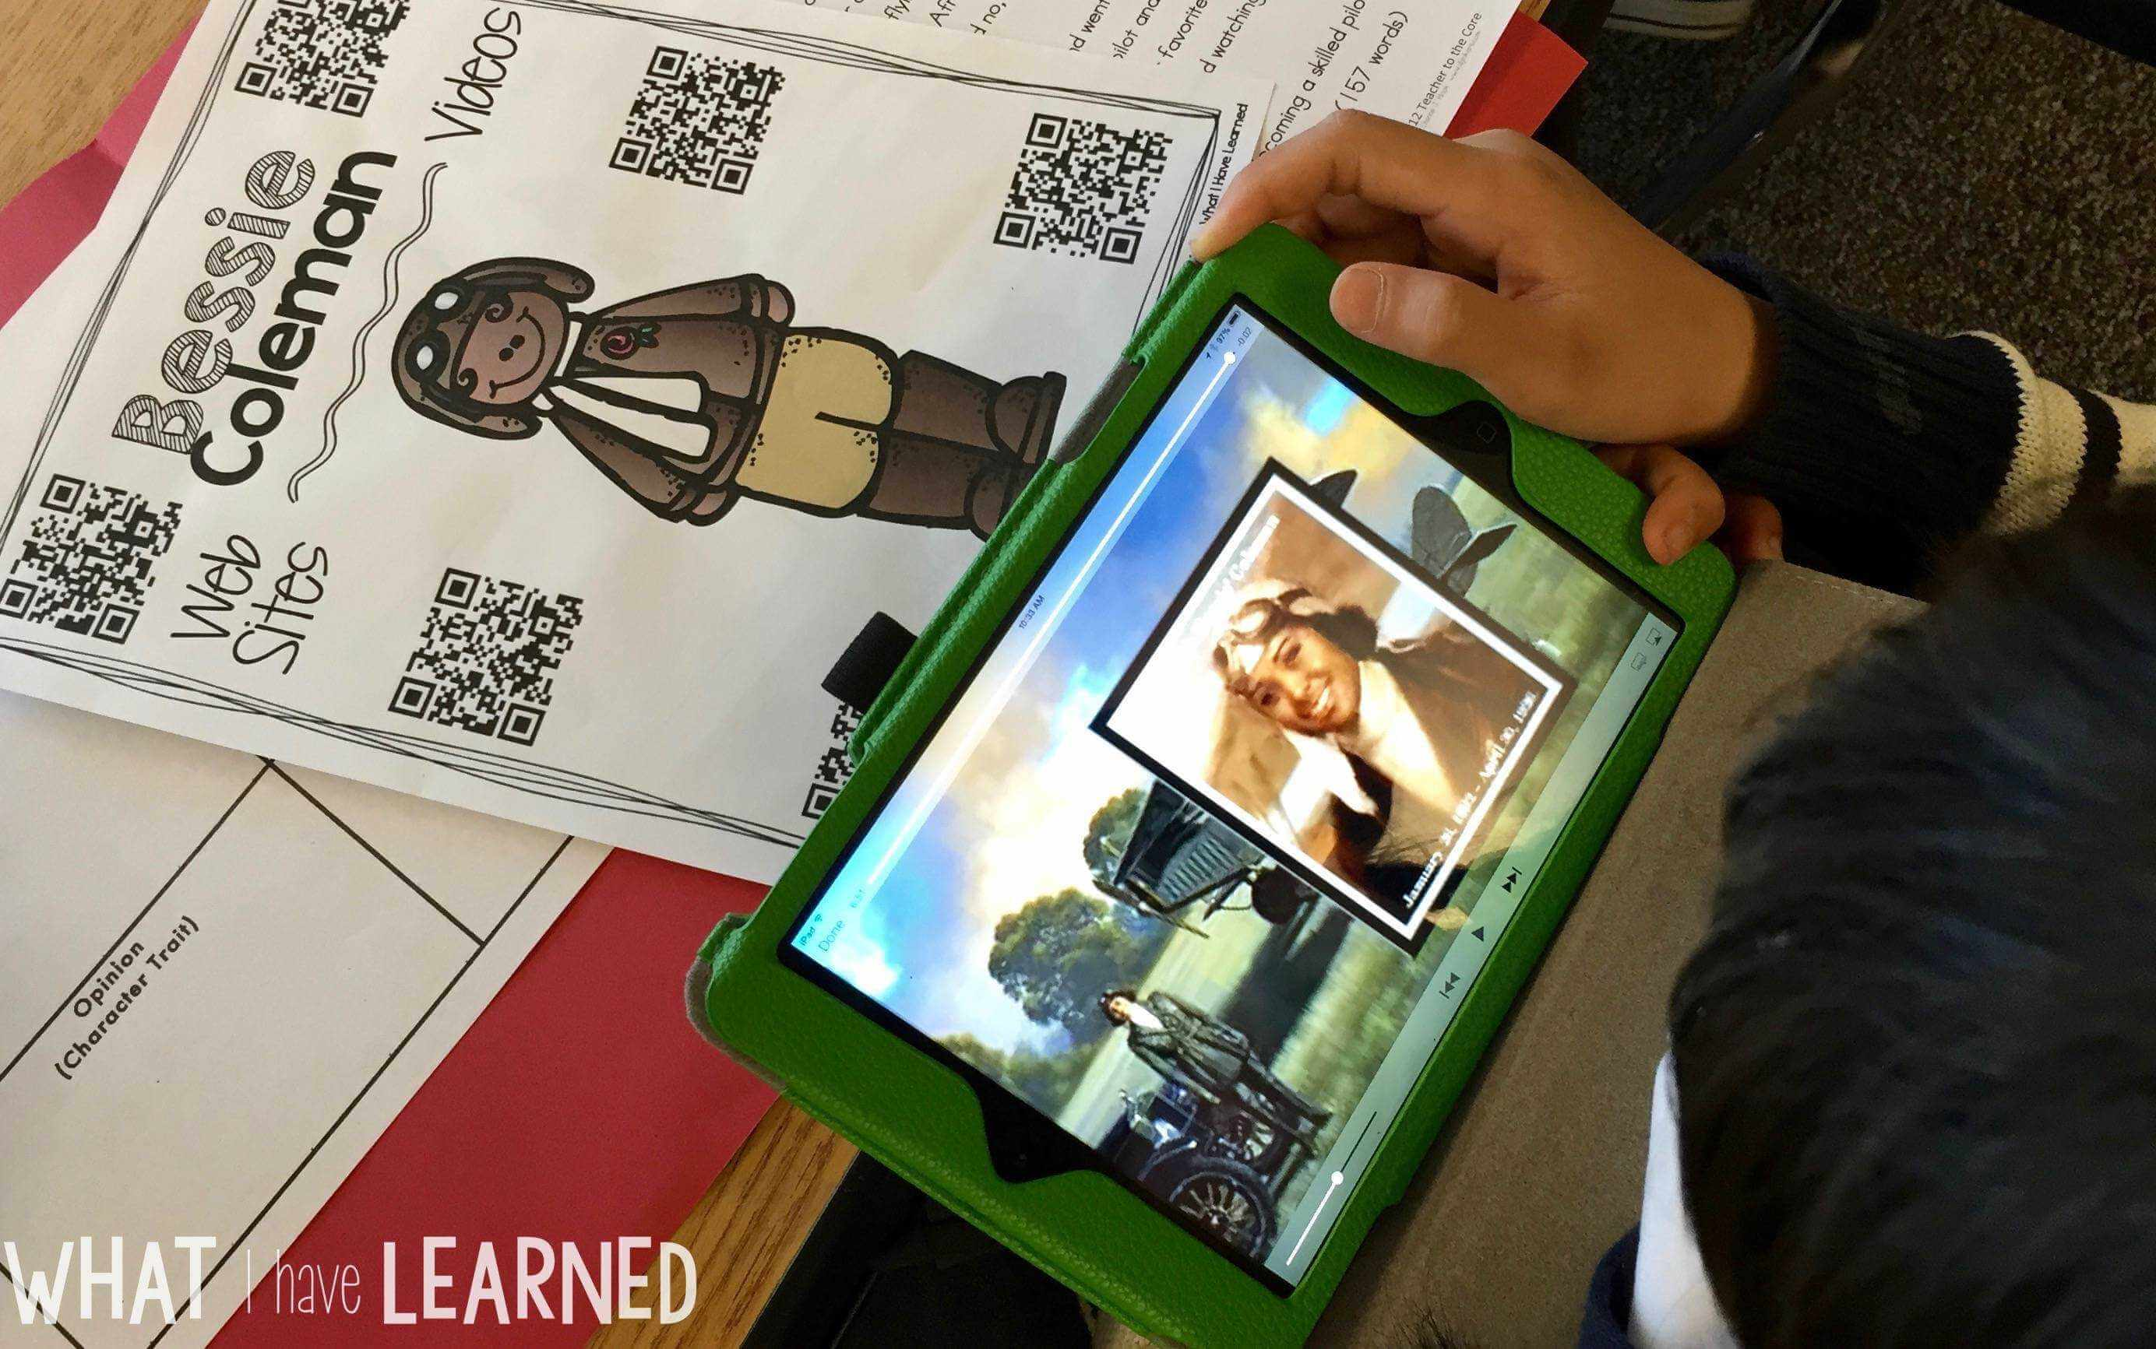
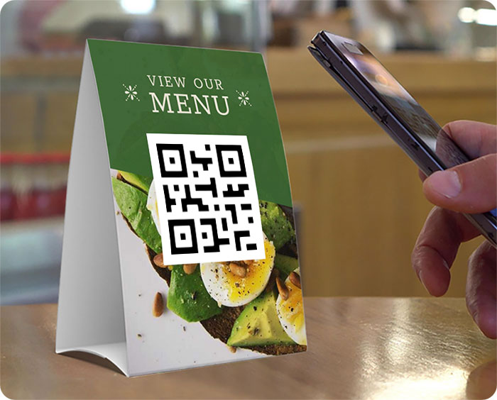
Marketing Buy Tickets Cashless Payment
Healthcare Education Restaurants

Slide 6
UML DIAGRAM
Activity Diagram
Class Diagram
Collaboration Diagram
Component Diagram
Data Flow Diagram
Deployment Diagram
ER Diagram
Sequence Diagram
State Transition Diagram
Use Case Diagram

Slide 7
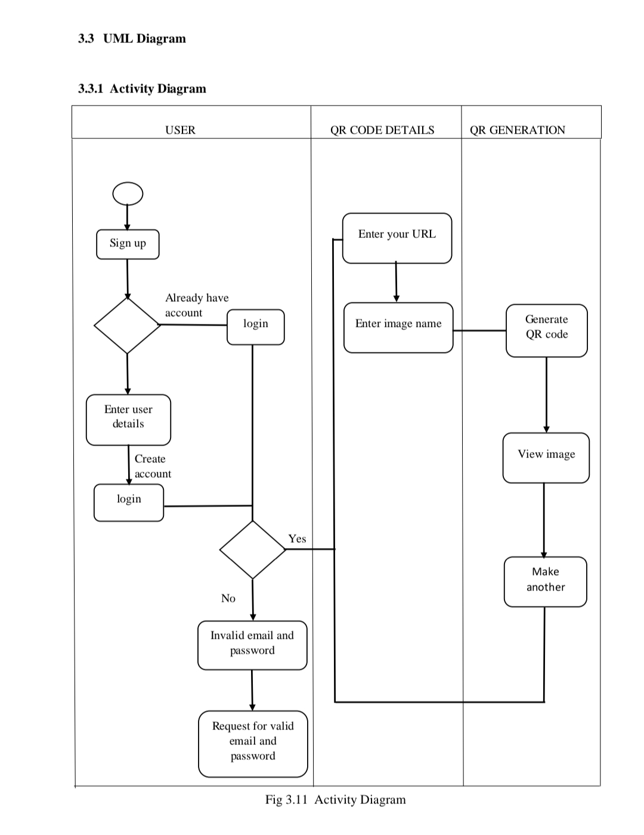
1. Activity Diagram

Slide 8
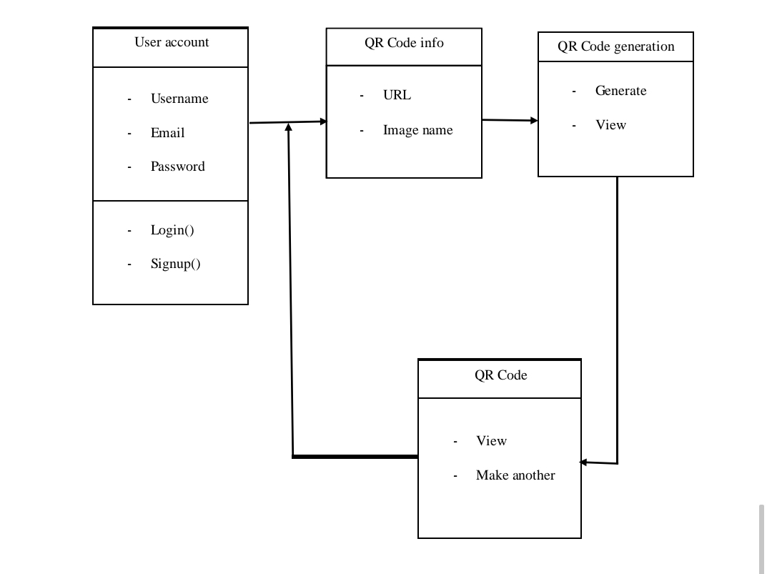
2. Class Diagram

Slide 9
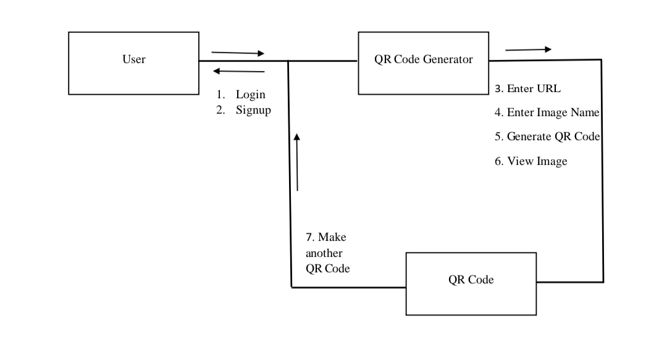
3. Collaboration Diagram

Slide 10
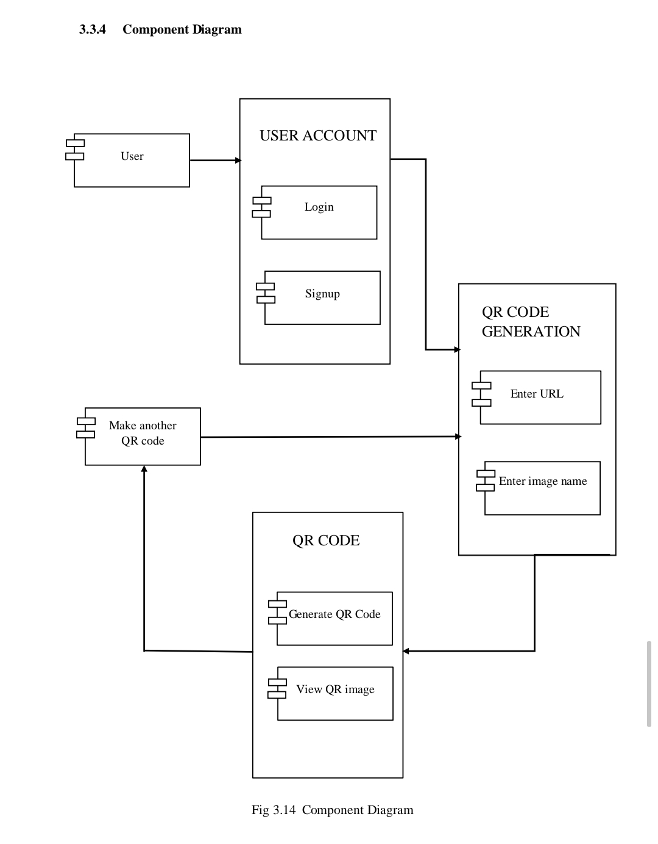
4. Component Diagram

Slide 11
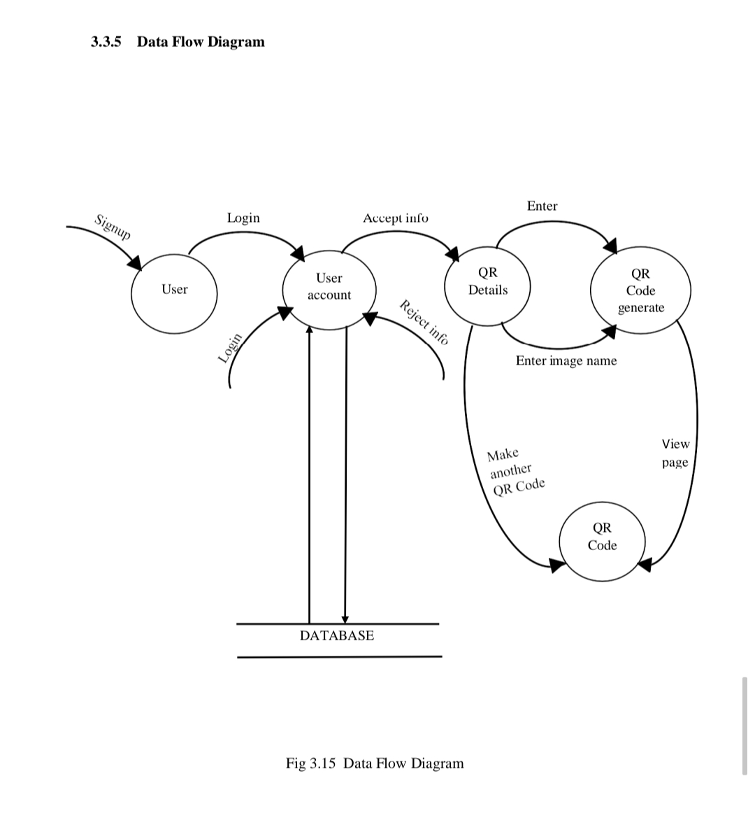
5. Data Flow Diagram

Slide 12
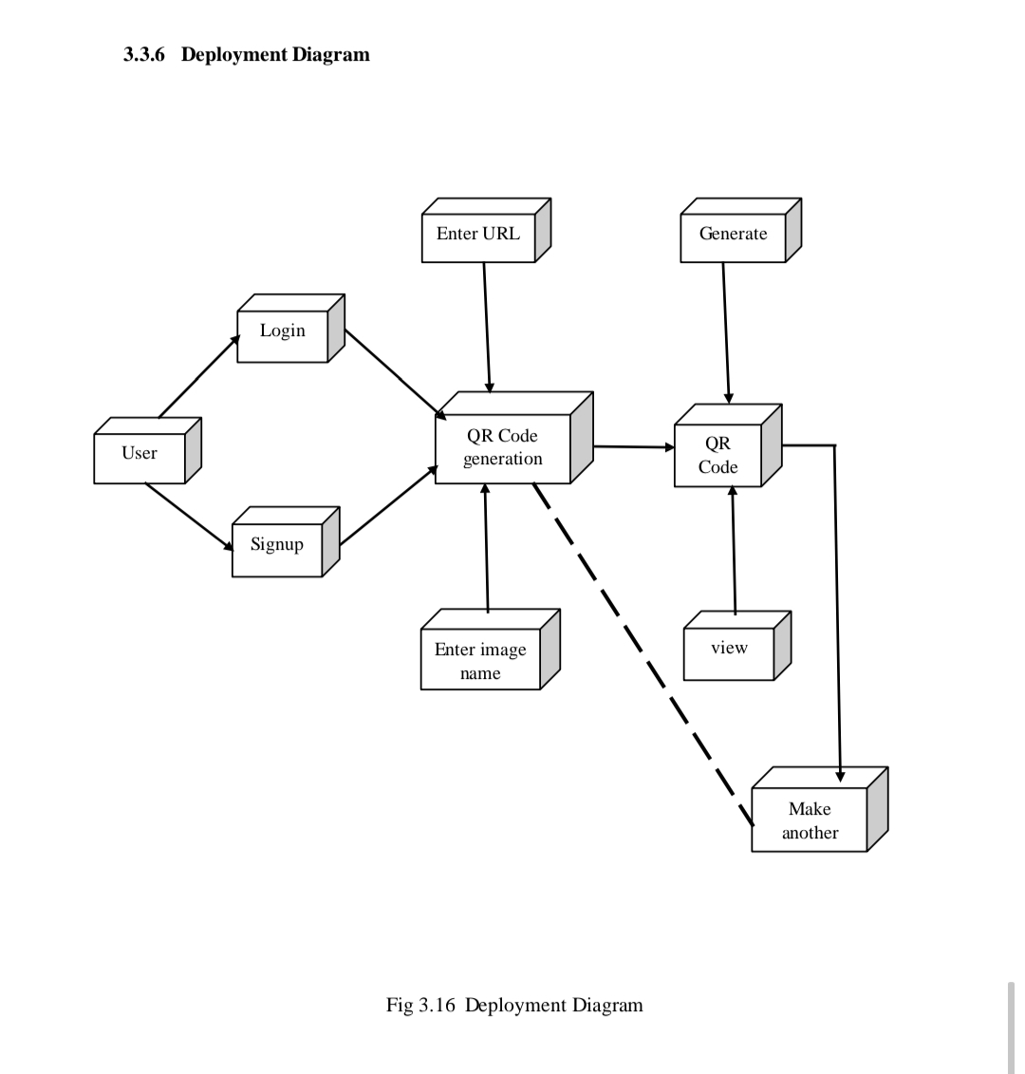
6. Deployment Diagram

Slide 13
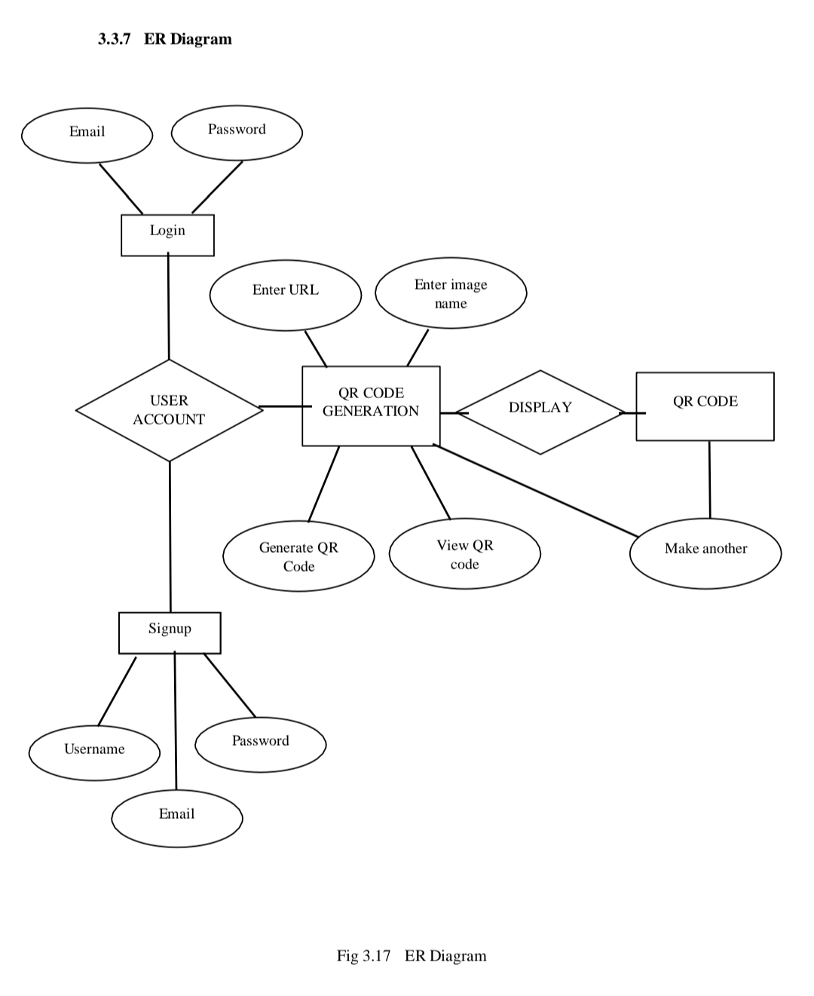
7. ER Diagram

Slide 14
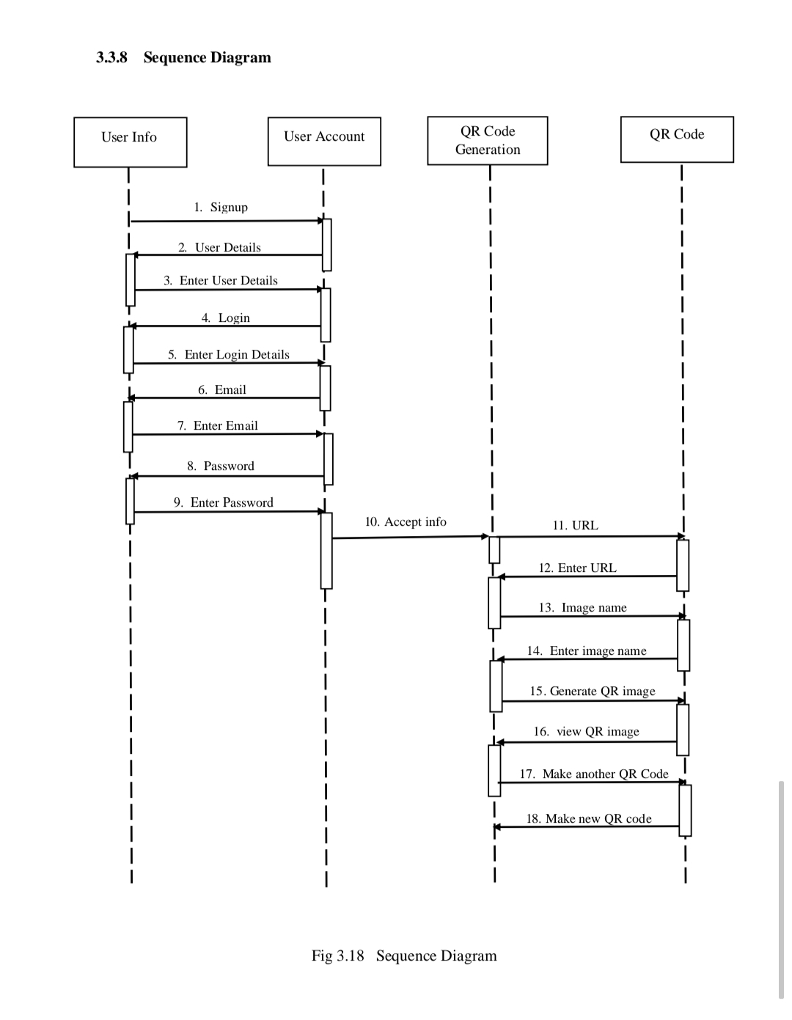
8. Sequence Diagram

Slide 15
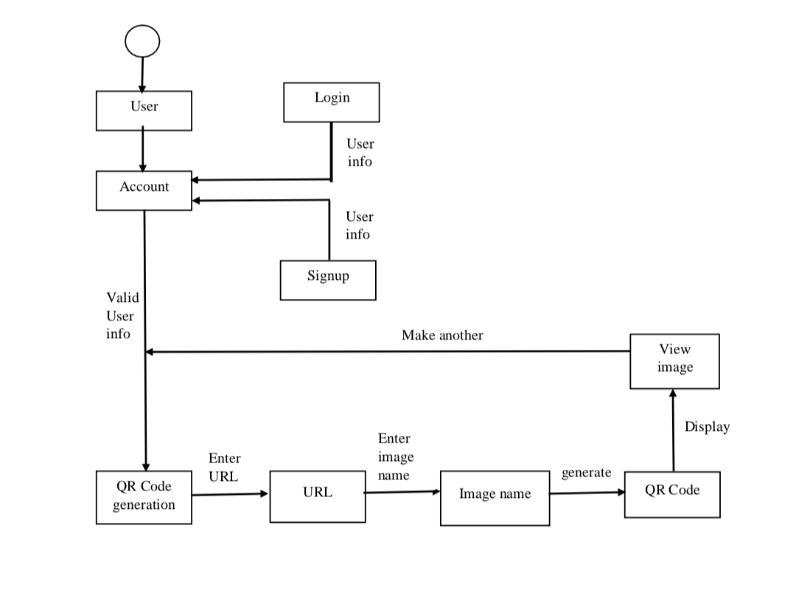
9. State Transition Diagram

Slide 16
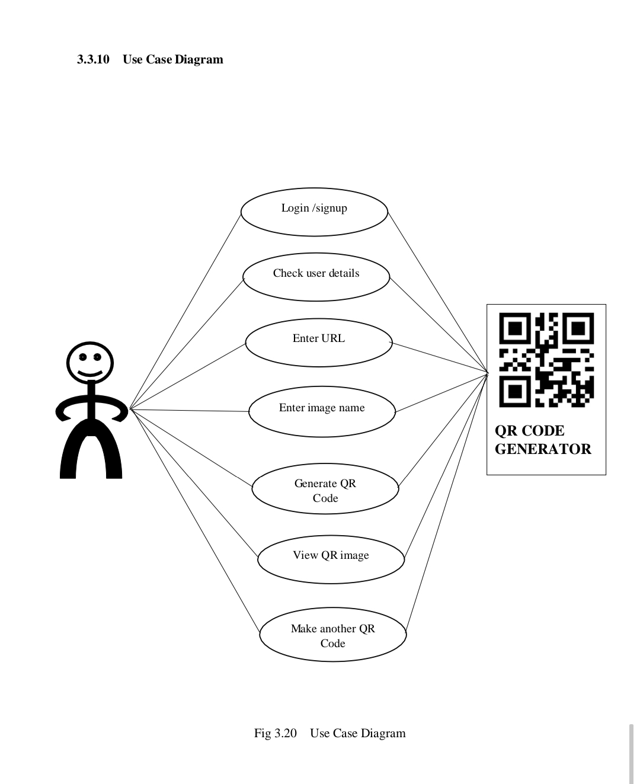
10. Use Case Diagram

Slide 17

Thank you !

